Slide 1

ECHOTRIBBLE
Collaboration Event
24 June 2026
UNCLASSIFIED
Notes:
Welcome to the ECHOTRIBBLE Collaboration Event.

Slide 2
UNCLASSIFIED
Agenda
Project Overview
Architecture & Core Capabilities
RFP Overview
Evaluation Criteria
Q&A Next Steps
UNCLASSIFIED

Slide 3


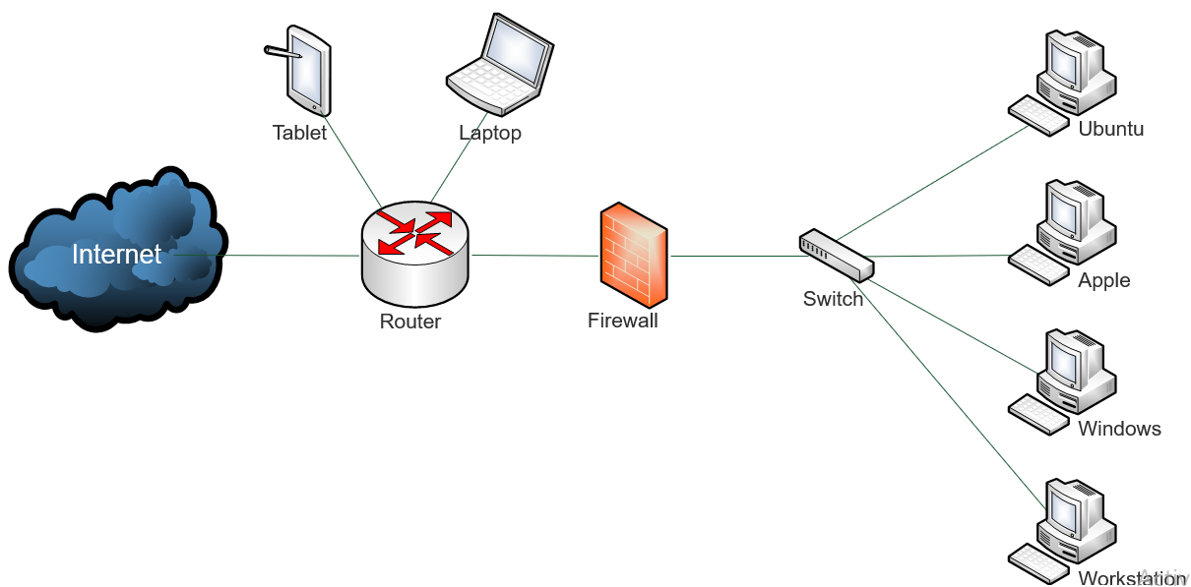
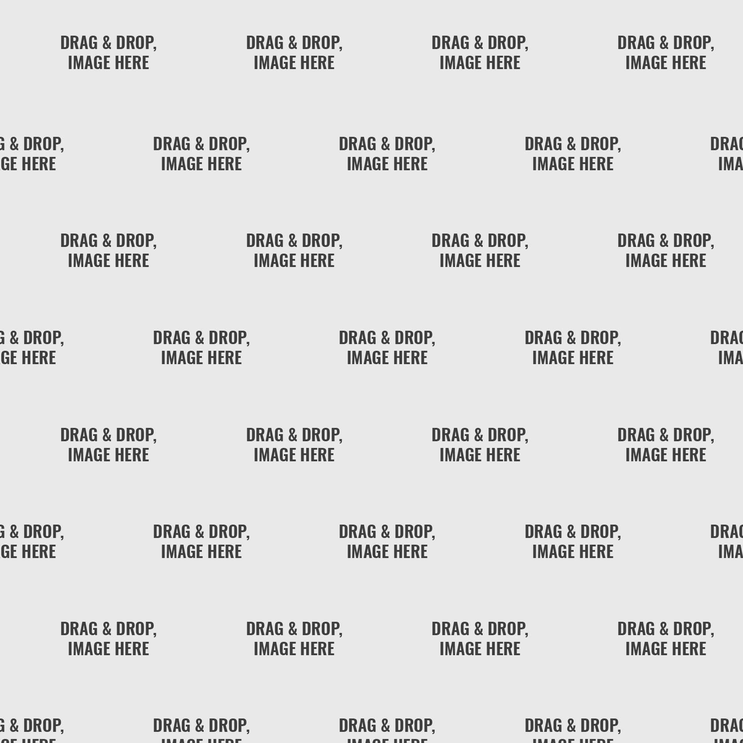
BACKGROUND
ECHOTRIBBLE
Maintaining command and control of cyber capabilities and capability placement is a complex and time-consuming process.
Software updates, software rollbacks, network connectivity, OS changes, other 3rd party binaries, etc. all impact the effectiveness and lifespan of cyber capabilities.
WHY: ARCYBER lacks a framework for command and control (C2) for AI agents
Notes:
Maintaining command and control of cyber capabilities and binary placement is a complex and time-consuming process. Software updates, software rollbacks, network connectivity, OS changes, etc. all impact the effectiveness and lifespan of cyber capabilities. In the small network illustrated, there are 8 possible targets but for simplicity we’ll focus on the wireless devices and the desktop machines.

Slide 4






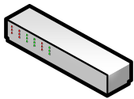
Network Scenario
iPad
Ubuntu
Ubuntu
Internet
Apple
Switch
Router
Firewall
Windows
Workstation
Notes:
In this network scenario, we have a couple of portable devices attached to the router and four desktops connected via a firewall. With access to the network, we emplace one of our EchoTribble binaries on the Ubuntu laptop. During a survey, the ET binary identifies other potential targets, and during the next scheduled communication window, requests and uploads the appropriate modules for propagating to other devices of interest on the network. The ET binary produces a replica of itself tailored specifically for the iPad, Apple desktop, and Windows 11 PC. The network changes and the Ubuntu desktop is replaced by an Apple and ET replicates again for that device.

Slide 5
Agentic C2 Agent - Architecture & Core Capabilities
Autonomous
Adaptive Anomaly Detection
Low-Observable Design
Self-directed behavior: configurable rule-based or prompt-driven logic for autonomous task execution
Lightweight heuristic engine capable of detecting behavioral, registry, or file anomalies
Memory-resident execution, randomized activity scheduling, and process name obfuscation
AGENTIC
C2 CORE
Rule-Bound Propagation
Plug-and-Play Modularity
Secure Remote Comms
Policy-driven cleanup and recovery routines; spreads only within defined authorization limits
Hot-swappable modules with operability across Windows, Linux, and macOS hosts
Covert, low-bandwidth beaconing with adjustable frequency; short-term state retention for contextual decision-making
Notes:
1. As somewhat illustrated in the previous slide, the Agentic C2 agent should be semi-autonomous, capable of navigating the network and performing certain rule-based tasks without human oversight.
2. The agent should be capable of detecting changes in the network (within scope) and within the machines(registry, behavior, and file). Potentially taking action against other binaries that may conflict/impact the effectiveness of the agent.
3. The agent should reside in-memory with randomized activity scheduling and have a toggle for persistence.
The agent will have defined rule-set(s) for propagation, self-recovery, and self-deletion.
Modularity will be key to this C2 framework, with modules for Windows, Linux, and macOS as the initial primary focus.
Communication channel(s) are low-bandwidth beaconing with tunable frequency via minimal CLI or local web service endpoint.

Slide 6
RFP Overview: What We Need From You
Proposal must address all six sections below:
1. Executive Summary
4. Implementation Plan
Proposed solution overview, key differentiators, Analytic Outcomes, high-level cost & schedule
Detailed schedule, milestones, resource plan, risk mitigation
2. Technical Approach
5. Cost Proposal
Architecture, modular integration, low/no footprint, anomaly detection, technology stack
Detailed cost breakdown by phase, labor rates, subcontractors (separate document)
3. DevSecOps & Compliance
6. Past Performance
DSOP pipeline alignment, security architecture, ATO compliance strategy
Relevant experience, references, team qualifications, case studies
Notes:
Please provide a whitepaper that focuses on the first five items with the sixth item provided in the addendum.

Slide 7
Evaluation Criteria
40%
Technical Approach
Architecture soundness, no persistent footprint, anomaly detection, modular, secure comms
25%
Modular Design
Self contained, independent modules, well-designed interface(s)
15%
Schedule & Resource Plan
Realistic prototype timeline, milestones, team qualifications, risk mitigation
15%
Cost
Competitive, transparent, and justified pricing by phase and deliverable
Factor
Past Performance
Relevant experience with similar application design and production successes

Slide 8
Innovation Path & Timeline
🔬
🤝
📋
🏆
🚀
ARCTIC Lab
& CFIC Partner
Collaboration Event
(TODAY)
RFP Release
& Proposal
Submission
Downselect
& Virtual Demos
B2B Contract & Prototype
Delivery
SQLite File
Available
(~Early MAY)
▶
▶
▶
▶
Period of Performance: ~6 months start to prototype delivery
Notes:
Here is the current timeline for the project.
RFP AE release o/a 20JUL26, with the grading period between 22JUL-13AUG26. This widow could adjust depending on the RFP AE release.
Down select project to be o/a 9-10SEP26.
Prototype delivery on/a 23NOV26.
Any questions?

